Slide 1
VIOLENCE AGAINST WOMEN...
Presentation by
Gurjot Kaur,
Additional Chief Secretary,
Woman & Child Development
Government of Rajasthan

Slide 2
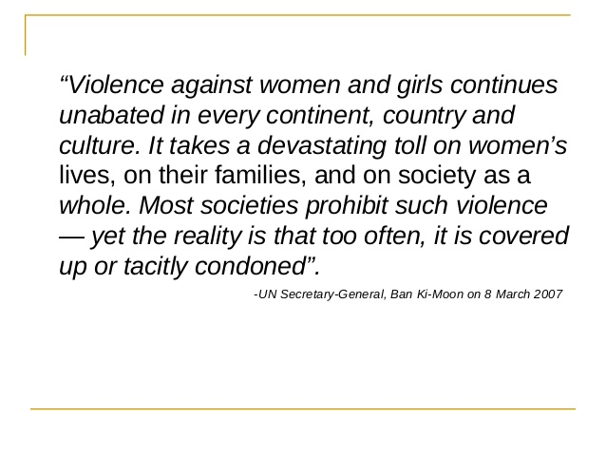

Slide 3
VIOLENCE : DEFINITION
According to UN, the most widely excepted definition of violence against women………………... any act of gender-based violence that results in, or is likely to result in, Physical, sexual, or psychological harm or suffering to women, including Threats of such acts, coercion, or arbitrary deprivations of liberty, whether occurring in public or private life.
The Indian Penal Code,1860 uses the word ‘Offence’ in place of ‘Violence’. Section 40 of IPC defines Offence as an act punishable by the code.
WHAT IS GENDER BASED VIOLENCE?
“violence that is directed against a woman because she is a woman or that
affects women disproportionately”
[General Recommendation No. 19 on VAW (GR 19)-CEDAW Committee]
The primary targets of GBV are women and adolescent girls

Slide 4
Major Crimes identified under the Indian Penal Code (IPC):
(1) Section 376 (rape)
(2) Kidnapping and abduction for different purposes (Sec.363 – 373 IPC)
(3) Homicide for dowry, dowry deaths or their attempts (Sec.302, 304-B IPC)
(4) Torture, both mental and physical
(Sec.498-A IPC)
(5) Importation of girls (up to 21 years of age.(Sec.366-B IPC)
(6) Molestation (Sec.354 IPC and Sexual harassment (Sec.509 IPC)
Major Crimes identified under the Special Laws :
1) Commission of Sati (Prevention) Act 1987
2) Dowry (Prohibition) Act 1961
3) Immoral Traffic (Prevention) Act 1956,
4) Indecent Representation of women (Prohibition) Act 1986
5) Pre-Conception, Pre-Natal Diagnostic Test Act, 1994
6) Protection of Women from Domestic Violence Act, 2005.
7) The Sexual Harassment of Women at Workplace (Prevention, Prohibition and Redressal) Act, 2013

Slide 5
Crime Against Women percent distribution during – National Scenario 2013
Source: NCRB, 2013

Slide 6
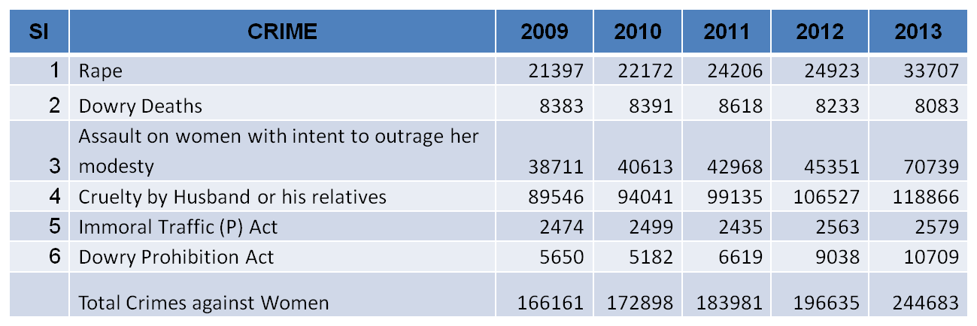
Crime against Women in last five years
Source: NCRB, 2013
National
Rajasthan

Slide 7
EFFORTS OF RAJASTHAN IN ADDRESSING VIOLENCE AGAINST WOMEN
To address the aforesaid situation, the state government has taken the following initiatives to end violence against girls and women
Separate Directorate as Directorate of Women Empowerment (2007)
Mahila Suraksha evam Salah kendra (2010-11) (MSSK)
State Girl Child Policy (2013)
One Stop Crisis Management Centre for Women (2013)- APARAJITA

Slide 8
Special Women Security Cell
For effective implementation and monitoring of the various schemes, programmes and different Acts designed for the protection of women from the various kinds of violence and exploitations,
Functional at the Directorate of Women Empowerment, Jaipur.
Headed by an officer of the State Administrative Services.

Slide 9
Girl Child Policy, 2013
Policy framed to focus on prevention of sex determination and female foeticides
Ensuring survival and providing appropriate environment for the development of girl child.
Role and responsibilities of each stakeholder have been identified and defined.
The State is first in the country to make this kind of move.
A Task Force has been constituted under the Chairmanship of the Chief Secretary, Government of Rajasthan for the effective monitoring of the policy.
The policy is being implemented in the State as per the directions of this Task Force.

Slide 10
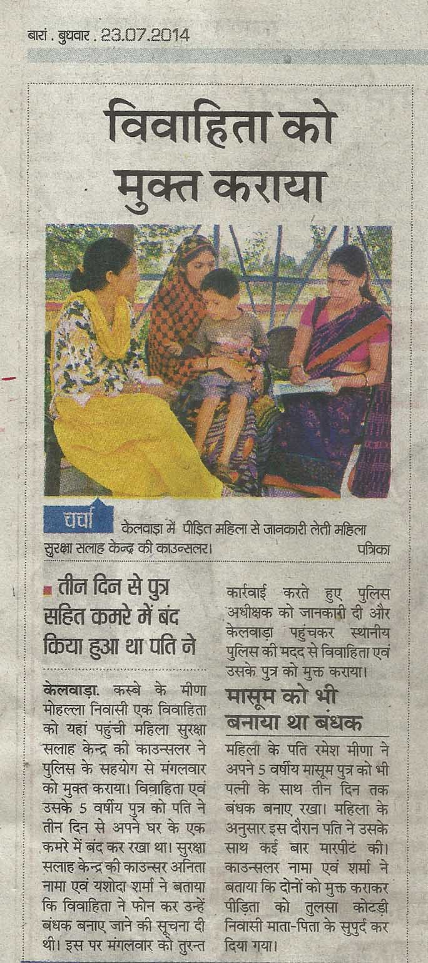
Mahila Suraksha Evam Salah Kendra (MSSK) (Women Protection and Counselling Centres)
Scheme initiated in the State in 2010-11.
40 centers at 40 police districts to provide counseling and legal/ police/medical assistance to the aggrieved woman;
The center aims to help against all kinds of violence, exploitation and harassment.
Centers are run by NGOs selected by the State Steering Committee on the basis of the recommendation of the Zila Mahila Sahayata Samiti.
21013 Women have been benefited till Nov, 2014.

Slide 11
Zila Mahila Sahayta Samiti
Chairman - Zila Pramukh of Zila Parishad
Vice chairman - District Collector
Members - (1) CJM/Judge, (2) S.P;, (3) Legal expert and (4) NGO
Member secretary- P.O(WCD)
Constituted for providing immediate relief to women who are victim of any kind of atrocity and/or exploitation/sexual harassment.
An apex body for overseeing the implementation of the Protection of Women from Domestic Violence Act, 2005 (PWDVA, 2005).
Authorized under the Mahila Suraksha Evam Salah Kendra Niyaman Evam Anudan Yojana, 2010 (revised 2013), to monitor the functioning of Mahila Surksha Evam Salah Kendra in the district.

Slide 12
Protection of Women from Domestic Violence Act, 2005 (Act No. 43 of 2005)
To provide for more effective protection of the rights of women guaranteed under the Constitution who are victims of violence of any kind occurring within the family and for matters connected therewith or incidental thereto.
Section 3 incorporated various category of actions defining them as violence at the domestic level. These categories are
Physical abuse
Sexual abuse
Verbal and emotional abuse
Economic abuse

Slide 13
Steps taken by the Government of Rajasthan for Implementation of PWDVA, 2005
All Deputy Director, ICDS, Programme Officer, Women Empowerment, CDPOs and Prachetas designated as Protection Officers.
33 New Posts of Protection Officers created in 2013-14 at the district level.
112 Service providers and 13 Shelter homes notified
All the District Hospitals, Satellite Hospitals, Sub-District Hospitals, CHC, PHC and Dispensaries have been notified for providing medical facilities under section 2 (j).

Slide 14
Protection of Women from Sexual Harassment at Work place
In compliance of the Hon’ble Supreme Court’s guidelines in the VISHAKHA Vs State of Rajasthan Case (1997), Complaints Committees were constituted in more than 350 departments/offices/ organizations/units in the state.
The District Collectors have been designated as District Officer to implement the provisions of the Sexual Harassment of Women at Workplace (Prevention, Prohibition and Redressal) Act, 2013 (Central Act No. 14 of 2013), Act vide notification dated 17.01.2014.
26 Local Complaints Committee and 80 Internal Complaints Committee in various departmental units have also been constituted.

Slide 15
APARAJITA: One Stop Crisis Management Centre for Women
Started on : 30.08.2013 in Govt. Jaipuria Hospital, Jaipur
First of its kind in the country.
OBJECTIVES :-
To provide relief to the harassed women at one place, through integrated & convergence efforts of different departments such as Medical & Health, Home, SLSA and WCD.
Single window to provide medical, legal, counselling and police assistance to aggrieved women.
It runs 24 X 7.
Cases disposed upto Dec. 2014: 863

Slide 16
HELP LINE FOR WOMEN
State Level Helpline No. 181 established in State Commission of Women
Police Helpline for Women
PADKAR YOJANA- A SCHEME FOR SELF DEFENCE TRAINING TO GIRLS
In compliance of the budget announcement in 2014-15, a programme for Self- Defence training to the girls has been started.
The Ministry of Youth & Sports Affair is the Nodal Department

Slide 17
One Stop crisis Management Center for Children- SNEH AANGAN
An initiative by Home Department and UNICEF.
It aims to prevent child- Trafficking and rehabilitation of the victim child.
Started on 16th June 2014.
Mahila Help Desks and Mahila Police Stations
Establishing Mahila Help Desks in all Thanas.
42 Mahila Thanas have been set up.
A separate State Level Women Atrocities Cell in Police Head Quarter to deal with cases of women atrocity.

Slide 18
IMPLEMENTATION OF PCPNDT ACT, 1994 IN RAJASTHAN
Total Registrations: 2331
Govt.: 188
Pvt.: 2143
Inspection & Action Taken Report (Since inception of the Act till Dec, 2014)
Inspections: 6692
Suspension / Cancellation: 170/ 354
Seal and Seizures: 417
Complaints filed in the court: 601
Convictions: 67

Slide 19
Contd ..
A Police Station in name of PCPNDT Bureau of Investigation, established
Jurisdiction extends to whole state
7 Special Upper CJM Courts at zonal headquarters for speedy disposal of cases pending under the PCPNDT Act, 1994

Slide 20
Hamaribeti Express (IEC Vehicle)
Religious, Social Fair & Govt. Cultural Program.
Programs in colleges through YDC, NSS & NCC.
Beti Janam Badhai Sandesh
Online Form-‘F’ and Tracking Devices
All Sonography centres are registered online
Sonography machines are connected with tracking devices
(Active Tracker or Silent Observer)
Complaints on 104 Toll Free Number
Mukhbir Yojna- Under the scheme, State Govt. has declared award of Rs.1,00,000/- to the “Mukhbir” for giving authentic information of sex selection. Till date 9 persons have been awarded.
Mukhyamantri Shubhlaxmi Yojana
To encourage the birth of Girl Child and to reduce Maternal Mortality Rate "Mukyamantri Shubhlaxmi Yojana" has been started from 1st April, 2013.
Beneficiary would get Rs 7,300/- in three installments on the birth of girl child

Slide 21
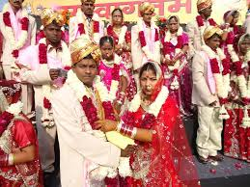
RAJASTHAN SAMUHIK VIVAH NIYAMAN EVUM ANUDAN NIYAM 2009
To encourage
community marriages,
marriage registrations,
curb heavy expenditures on marriages and
to prevent social ill practices like child marriage, dowry etc.
Grant given per couple =
Rs 12,500/- out of which Rs 10,000/- goes to bride & Rs 2500/- to the organiser.
13341 couples benefitted up to Dec, 2014)

Slide 22
Sensitization Programmes conducted by Directorate of Women Empowerment (2014-15)
Refresher Training to all the Counselors working in the MSSKs.
District level one day workshops for the orientation and sensitization of the DLOs of the related departments.
Training to the 70 Govt. departments regarding the Sexual Harassment Of Women At Work Place (Prevention, Prohibition And Redressal) Act, 2013.
Two day training to the Programme officers, WE.
Training to all the Protection Officers of Jaipur district designated under the Protection of Women from Domestic Violence, 2005.

Slide 23
CONSTRAINTS AND RECOMMENDATIONS
Extension of Aparajita Model to all Districts so that incidences of violence could be addressed more effectively.
For the effective implementation of PWDVA, 2005 :-
Office of Protection Officer should be strengthened.
Incentive/Administrative Charges to the Service Providers registered under the ACT.
Short Stay Homes should be established at all District Head Quarters.
For the effective implementation of the Sexual Harassment of Women at Workplace (Prevention, Prohibition and Redressal) Act, 2013
Funds for honorarium for Local Complaints Committee meetings
Establishing a Monitoring System at state level for effective implementation of both the above acts.

Slide 24
Contd ..
Sensitisation of Judiciary and Police functionaries in view of the above two acts.
Awareness Workshops for newly elected PRI's Members.
Third Party Mapping and Survey of Sonography Machines for effective implementation of PCPNDT Act, 1994.

Slide 25
THANK YOU

